Slide 1
Back to School 2020-2021 Update October 22
Jennifer Morse, MD, MPH, FAAFP
Medical Director
CMDHD/MMDHD/DHD#10

Slide 2
This meeting is for School and Health Department Staff
If you have questions, please send them to:
For Roscommon, Osceola, Clare, Gladwin, Arenac, Isabella Counties:
info@cmdhd.org
For Missaukee, Crawford, Kalkaska, Wexford, Lake, Mason, Manistee, Oceana, Newaygo, Mecosta Counties
info@dhd10.org
For Montcalm, Gratiot, Clinton Counties
https://www.mmdhd.org/contact/
We have limited time to cover all our topics. The slides and recordings will be available on our websites within 1-3 days.
https://www.dhd10.org/coronavirus/
https://www.mmdhd.org/novel-coronavirus/
https://www.cmdhd.org/novel-coronavirus

Slide 3
Please make sure all needed information is passed to school secretaries, nurses, etc.

Slide 4
A Look at the Data…
Rationale for Monitoring Epidemiologic COVID-19 Data And School Reopening
Rising case rates in schools could result in more transmission in the community
Rising case rates in the community could result in more transmission in the school
Therefore, rising incidence in either school OR community should prompt action
From COVID-19 School and Community Resource Library https://www.massgeneral.org/assets/MGH/pdf/medicine/infectious-diseases/COVID-19%20School%20and%20Community%20Resource%20Library_July%206%202020.pdf#page=12&zoom=100,96,96

Slide 9
Official School COVID 19 Case Counts by The Covid Monitor (Cumulative Cases) https://experience.arcgis.com/experience/fb52d598982f41faac714b5ebe32e7d1

Slide 10
Review of Data

Slide 11
Counties where symptomatic students should have evaluation prior to return to school* *Also should have evaluation if any concern for exposure to COVID-19, or at the discretion of the school or family
ALL OF THEM

Slide 12
Emergency Orders Under MCL 333.2253 All orders can be found at https://www.michigan.gov/coronavirus/0,9753,7-406-98178_98455-533660--,00.html
Emergency Order Under MCL 333.2253 – Gathering Prohibition and Face Covering Order reissued October 9th
Order https://www.michigan.gov/coronavirus/0,9753,7-406-98178_98455-541962--,00.html
Infographic https://www.michigan.gov/documents/coronavirus/Epidemic_Order_1-page_Oct._9_FINAL_704765_7.pdf
Fact Sheet https://www.michigan.gov/documents/coronavirus/MDHHS_Epidemic_Order_Oct._9_FINAL_704767_7.pdf

Slide 13
Changes
Additions:
Gathering at a retail store, library, or museum may not exceed 50% of total occupancy limit established by Fire Marshal.
Gatherings at recreational sports and exercise facilities cannot:
exceed 25% of the total occupancy limits established by the Fire Marshal
Have less than six feet of distance between each workout station.
Gatherings at professional sports and entertainment facilities, including arenas, cinemas, concert halls, performance venues, sporting venues, and stadiums and theater must ensure that patrons not of the same household maintain six feet of distance (e.g. stagger group seating upon reservation, close off every other row, etc.).
Gatherings at indoor pools may not exceed 25% of bather capacity limits

Slide 14
Face Covering
“Face covering” means a covering that covers at least the nose and mouth.
(c) All child-care organizations must not permit gatherings unless face coverings are worn by:
(1) All staff and all children 2 years and older when on a school bus or other transportation provided by the child-care organization or camp;
(2) All staff and all children 4 years and older when in indoor hallways and common areas. Face coverings should be encouraged for children 2 years and older when in indoor hallways; and
(3) All staff and all children 5 years and older when in classrooms, homes, cabins, or similar indoor settings. Face coverings should be encouraged for children 2 years and older when in these settings.

Slide 15
Contact Tracing
Follow facilities must maintain accurate records, including date and time of entry, names of patrons, and contact information, to aid with contact tracing, and denies entry for a gathering to any visitor who does not provide, at a minimum, their name and phone number:
(1) All businesses or operations that provide barbering, cosmetology services, body art services (including tattooing and body piercing), tanning services, massage services, or similar personal care services;
(2) Sports and entertainment facilities (except outdoor, unticketed sporting events), including arenas, cinemas, concert halls, performance venues, sporting venues, stadiums and theaters, as well as places of public amusement, such as amusement parks, arcades, bingo halls, bowling centers, skating rinks, and trampoline parks;
(3) Gymnasiums, fitness centers, recreation centers, exercise facilities, exercise studios, bowling centers, roller rinks, ice rinks, and like facilities.

Slide 16
Band, Choir and Orchestra Guidance from MDHHS 10/13/20
Should wear cloth face coverings and socially distance at all times.
Slit masks are permitted only while students are playing wind or brass instruments.
(Note from me: An example of slit masks for purchase is here: https://www.swbandproducts.com/store/double-layer-performance-face-mask-for-brass-and-wind-players-with-optional-perfomance-slit-3-pack.html ; You can also just put a small straight slit in a pleated surgical style mask)
Place students facing the same direction with a distance of at least 6 feet between each child in all directions.
Vocal performances should be conducted with cloth face coverings on and the maximum possible distancing.
Six feet of distance is the minimum recommendation, and 12 feet is preferred when possible
All music stands, chairs, and other frequently touched surfaces should be disinfected between classes.
When possible, instruments should be fitted with bell covers consisting of a minimum of two layers of dense fabric. Bell covers should be made of a non-stretchy material
Spit valves should be emptied away from others into an absorbent, disposable material that can be discarded

Slide 17
Band, Choir and Orchestra Guidance
Classes should be held outdoors whenever possible.
If classes must be held indoors then occupancy should be decreased, and spacing should be increased as much as possible
If indoor practice is unavoidable, ventilation should be improved in the following ways
Doors and windows should be open unless this poses safety or health risk
Strategic fan placement in exhaust mode can help draw fresh air into the room
Ensure ventilation systems are functioning and maintain air quality for the room’s occupancy level. Inspect air filters
Consider running the HVAC system at maximum outside airflow for two hours before and after the school is occupied.
Portable high-efficiency particulate air (HEPA) fan/filtration systems may be used to enhance air cleaning.

Slide 18
DEADLINE NOV. 15th: Michigan K-12 Public School HVAC Assistance Program https://www.michigan.gov/climateandenergy/0,4580,7-364-85453_85455_85516_85523-539583--,00.html
This program will survey Michigan K-12 public schools to gather information on their HVAC systems and identify schools needing assistance with recommendations to reduce infectious aerosol transmission.
take a confidential survey to gather basic information on their HVAC systems, recent improvements, and current needs.
Completing the survey will assist the State in assessing the status of Michigan schools’ HVAC systems.
Schools completing the survey are eligible to request free assistance with recommendations to reduce infectious aerosol transmission.
Energy Services is extending funding to Michigan licensed HVAC contractors to complete the onsite HVAC inspection checklist to make recommendations and cost estimates for implementation.
The maximum award is $15,000 per applicant, with a maximum payment of $1,500 per completed checklist. Awards will be given on a first come, first served basis until funding is depleted.

Slide 19
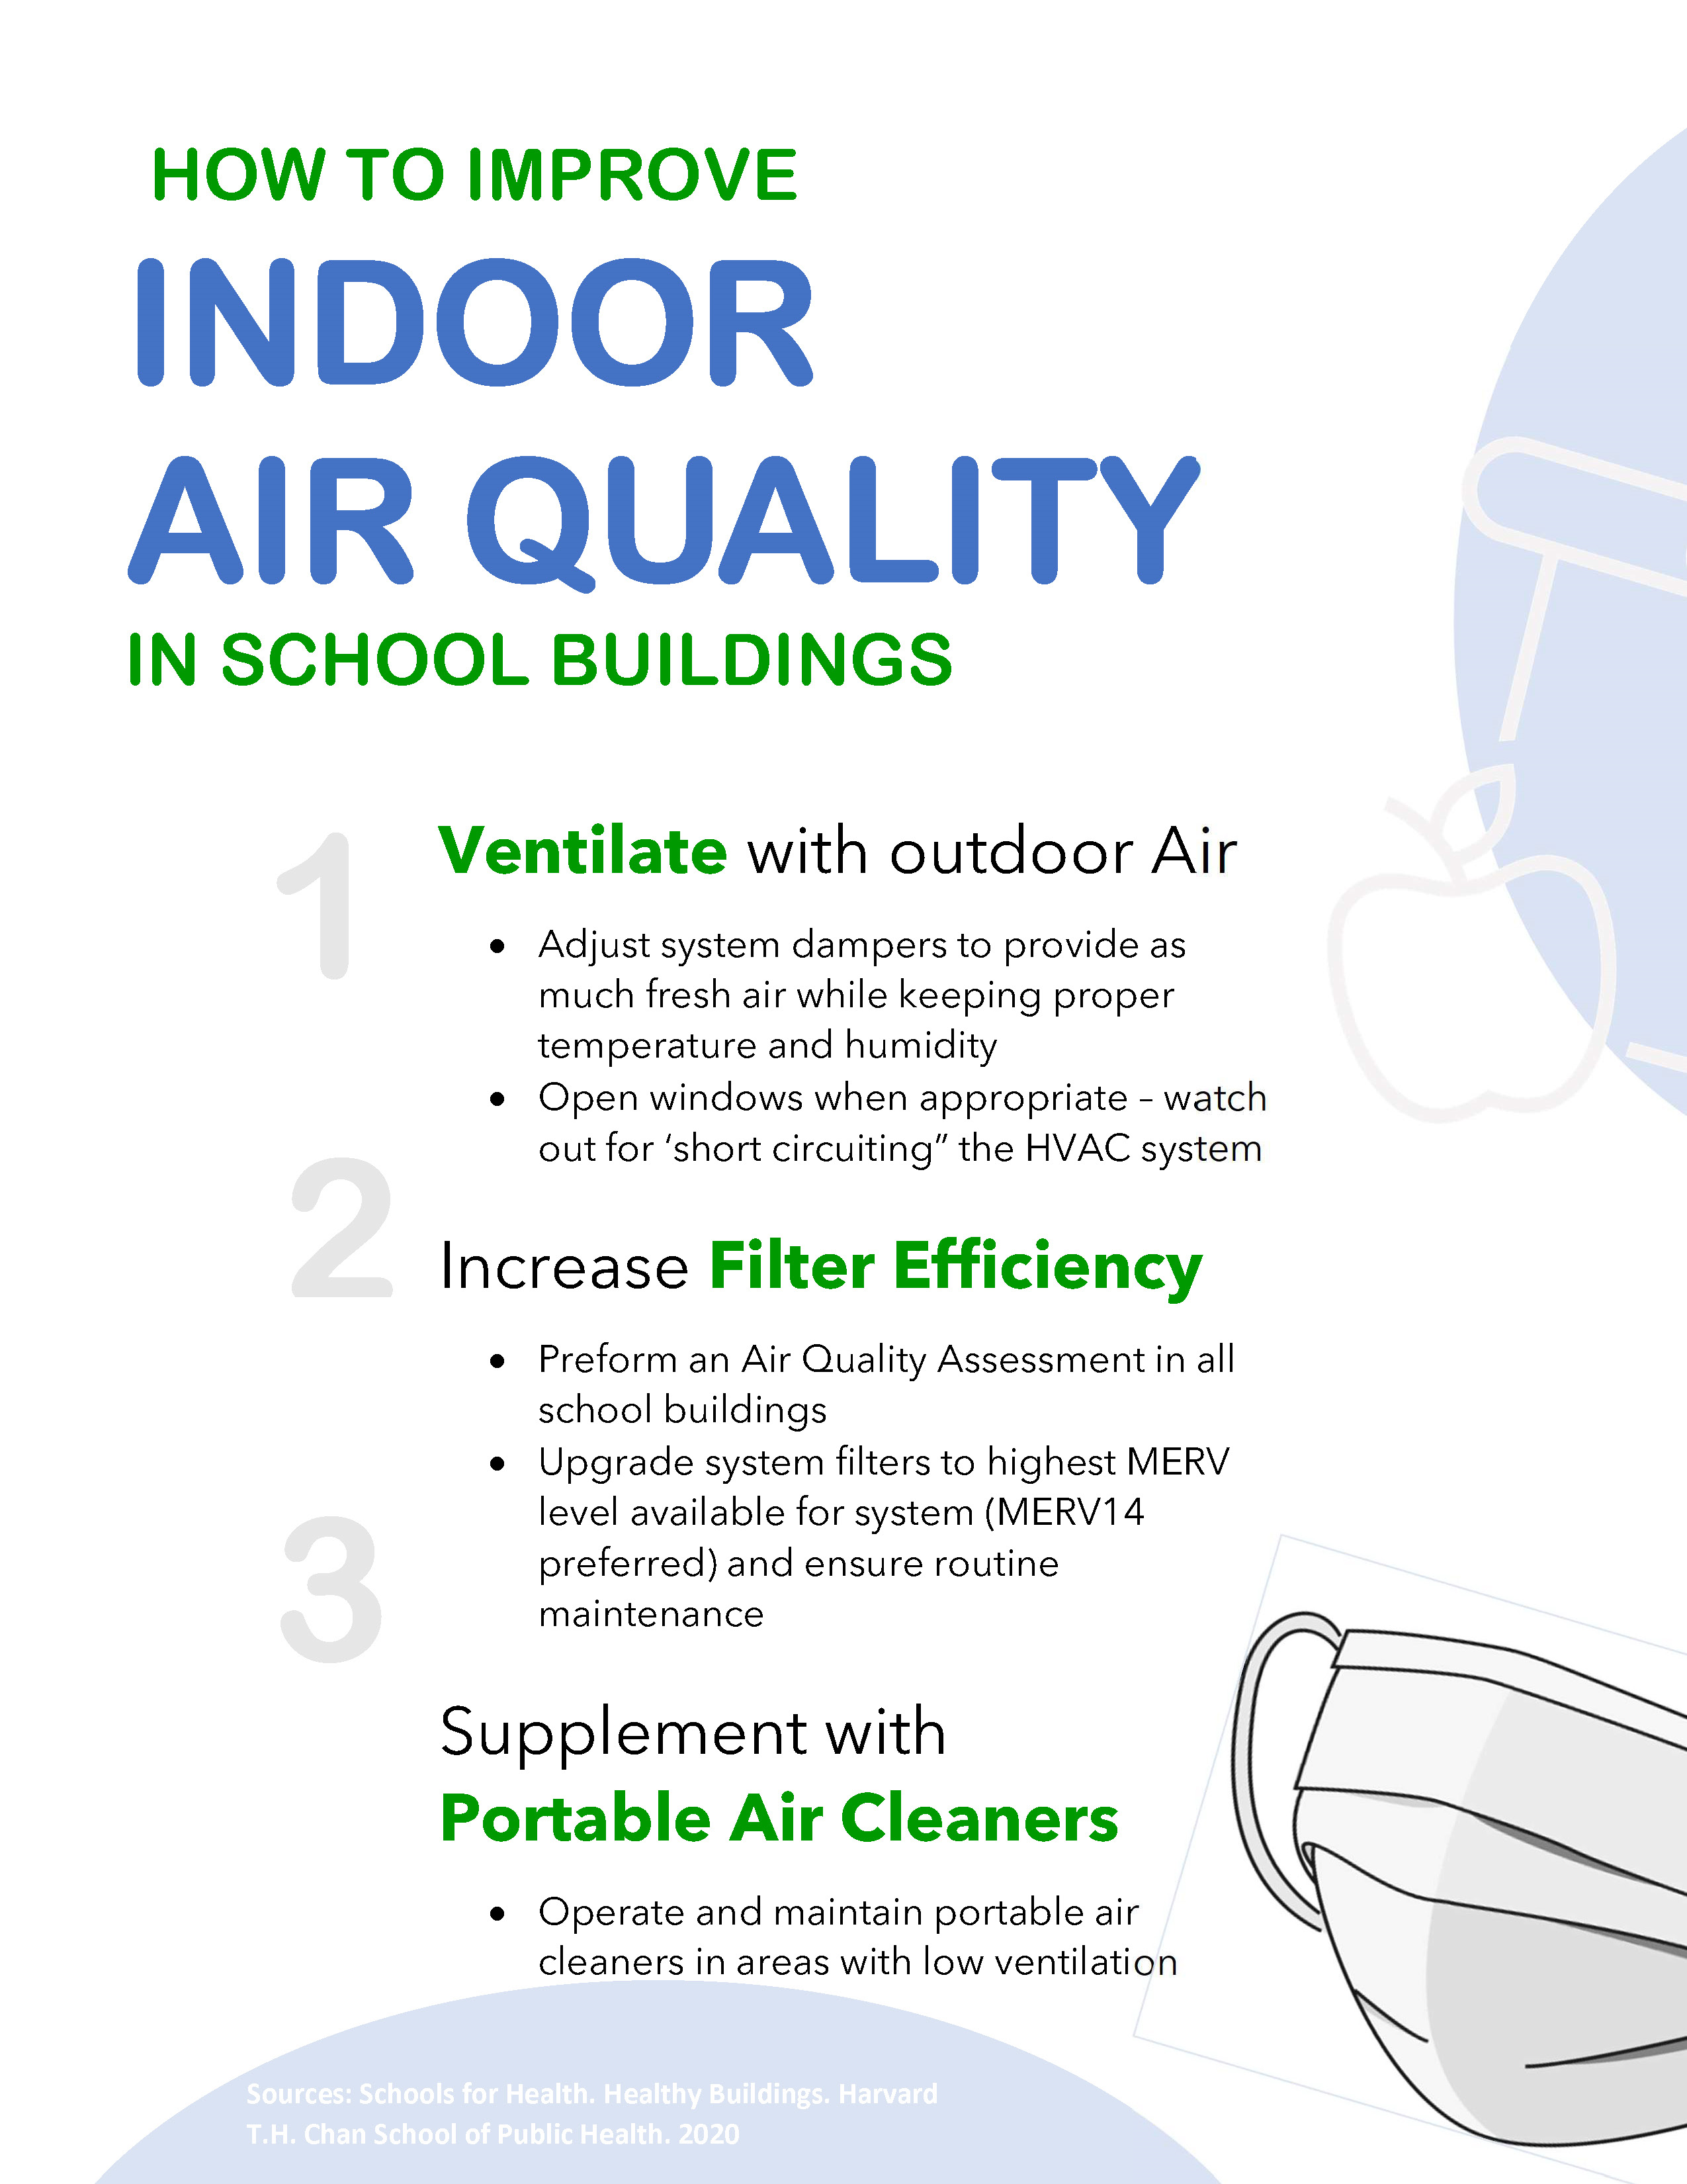
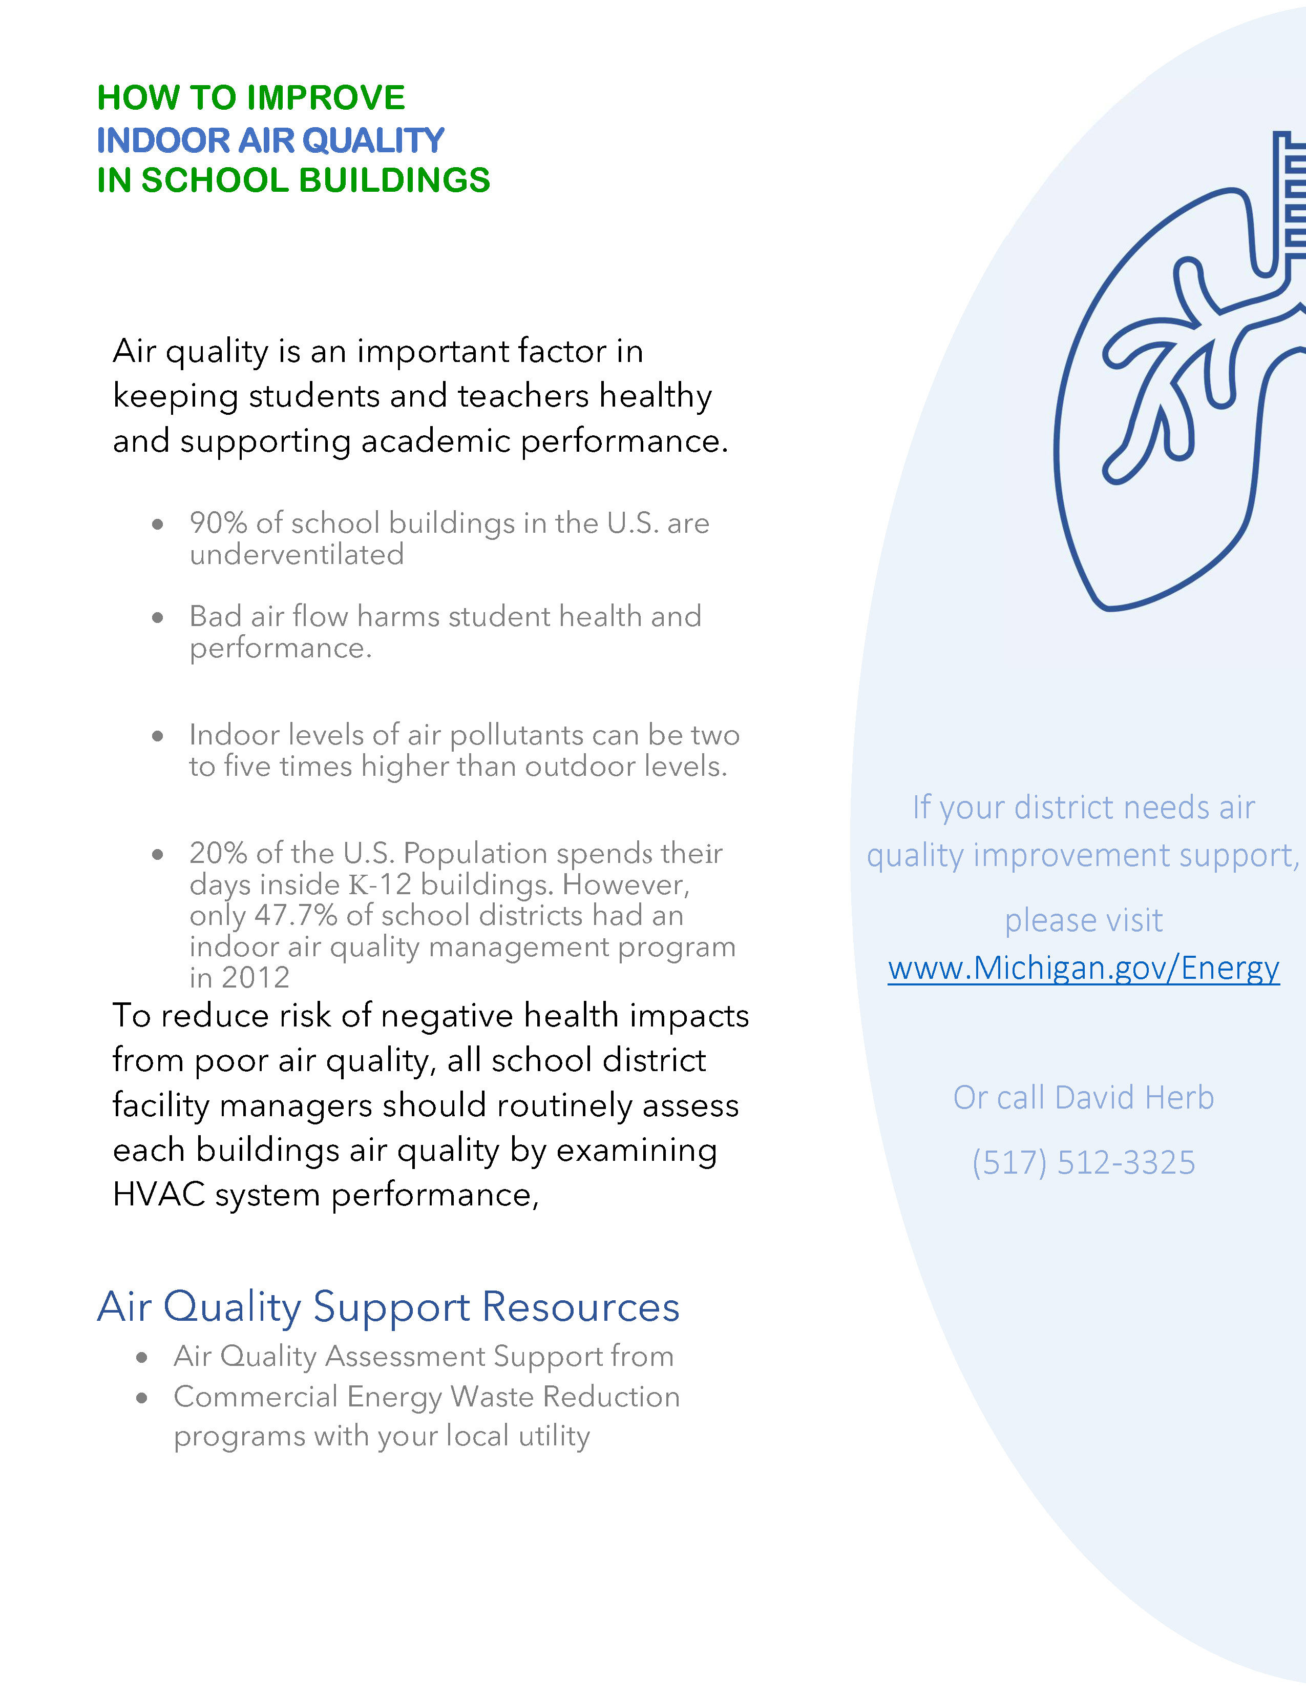
https://www.michigan.gov/documents/climateandenergy/Air_Quality_Best_Practices_704300_7.pdf

Slide 20
Still Questions re: Employees…
Per the CDC Business and Workplace Guidance:
“What should I do if an employee comes to work with COVID-19 symptoms? Sick employees should follow CDC-recommended steps to help prevent the spread of COVID-19. Employees should not return to work until they have met the criteria to discontinue home isolation.” (No where does it say “or have a negative test) they have met the criteria to discontinue home isolation.” (No where does it say “or have a negative test)
Per the OSHA: Guidance on Return to Work (pg. 12):
“Because of the limitations of current testing capabilities*, employers should act cautiously on negative SARS-CoV-2 test results. Employers should not presume that individuals who test negative for SARS-CoV-2 infection (i.e., the virus that causes COVID-19) present no hazard to others in the workplace.”
So: our guidance is that employees that have ONE of the following: new/different/worse from baseline of any chronic illness: fever/feverish, cough, shortness of breath or TWO of the following: muscle aches without another explanation, chills, sore throat, headache, vomiting/diarrhea, loss of taste or smell do not return to work until it has been 10 days since the onset of symptoms and 24 hrs with no fever and symptoms have improved (i.e., they have met the criteria to discontinue home isolation). Testing negative would not factor into this.
If you as an employer you wish to allow staff with negative test results return to work, you can make that your policy.
*Some things to keep in mind: The rate of false negative results on PCR test, in those infected and symptomatic, # of days after exposure have been reported as:
day 1: 100%;
day 4: 67%;
day 5: 38%;
day 8: 20%;
day 9: 21%;
and then rising to 66% on day 21
Source: https://www.acpjournals.org/doi/full/10.7326/M20-1495
And adults have been shown time and again to be more likely to spread illness than children

Slide 21
Close Contact Definition, update 10/21 CDC https://www.cdc.gov/coronavirus/2019-ncov/php/contact-tracing/contact-tracing-plan/appendix.html
Someone who was within 6 feet of an infected person for a cumulative total of 15 minutes or more over a 24-hour period* starting from 2 days before illness onset (or, for asymptomatic patients, 2 days prior to test specimen collection) until the time the patient is isolated.
* Individual exposures added together over a 24-hour period (e.g., three 5-minute exposures for a total of 15 minutes). Data are limited, making it difficult to precisely define “close contact;” however, 15 cumulative minutes of exposure at a distance of 6 feet or less can be used as an operational definition for contact investigation. Factors to consider when defining close contact include proximity (closer distance likely increases exposure risk), the duration of exposure (longer exposure time likely increases exposure risk), whether the infected individual has symptoms (the period around onset of symptoms is associated with the highest levels of viral shedding), if the infected person was likely to generate respiratory aerosols (e.g., was coughing, singing, shouting), and other environmental factors (crowding, adequacy of ventilation, whether exposure was indoors or outdoors). Because the general public has not received training on proper selection and use of respiratory PPE, such as an N95, the determination of close contact should generally be made irrespective of whether the contact was wearing respiratory PPE. At this time, differential determination of close contact for those using fabric face coverings is not recommended

Slide 22
Possible misinformation recently shared…
Contact tracers assisting via the state health department may have provided some inaccurate information recently (there have been several new hires recently).
Some close contacts may have been told all of their family members need to quarantine
We wish to clarify. Close contacts to cases of COVID-19 do need to quarantine for 14 days past the date of their last exposure. However, the contacts of these close contacts, such as their family members, do not need to be in quarantine unless they themselves have been exposed to someone with COVID-19.
This information can be found on the CDC at https://www.cdc.gov/coronavirus/2019-ncov/faq.html#Contact-Tracing under “Contact Tracing” section:
What if I have been around someone who was identified as a close contact?
If you have been around someone who was identified as a close contact to a person with COVID-19, closely monitor yourself for any symptoms of COVID-19. You do not need to self-quarantine unless you develop symptoms or if the person identified as a close contact develops COVID-19.

Slide 23
Questions?
Contact:
Jen Morse, MD, MPH, FAAFP
jmorse@cmdhd.org
Cell: 989-802-2590
For Roscommon, Osceola, Clare, Gladwin, Arenac, Isabella Counties:
Steve Hall, R.S., M.S.
shall@cmdhd.org
989-773-5921, Ext. 1421
www.cmdhd.org
For Missaukee, Crawford, Kalkaska, Wexford, Lake, Mason, Manistee, Oceana, Newaygo, Mecosta Counties
Kevin Hughes, MA
khughes@dhd10.org
(231) 876-3839
www.dhd10.org
For Montcalm, Gratiot, Clinton Counties
Marcus Cheatham, PhD
mcheatham@mmdhd.org
989-287-0701
www.mmdhd.org

